Slide 1
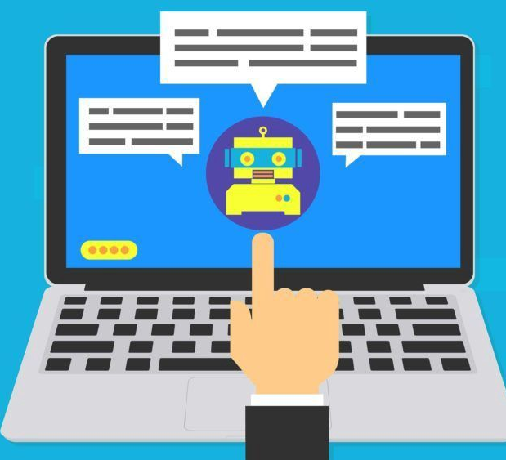

Chatbot Application
Prepared By :
SHOKER Sami

Slide 2
NLP Processing pipeline
Tokenizing
Stemming
Excluding Punctuation Characters
Bag of Words

Slide 3
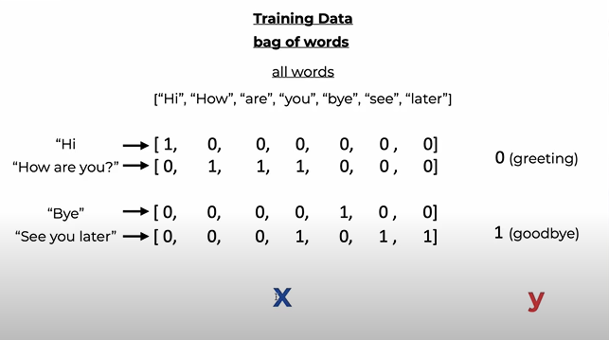

Slide 4
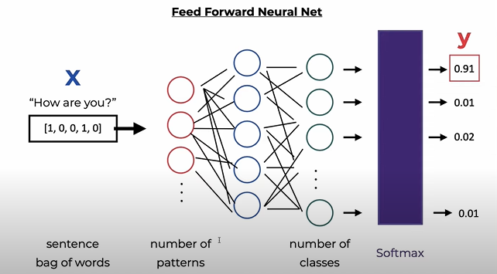
Model Training

Slide 5
Chatbot deployment
Backend
FLASK
Frontend
HTML
CSS

Slide 6
References & Data Sources
https://github.com/python-engineer
https://chatbotsmagazine.com/contextual-chat-bots-with-tensorflow-4391749d0077
https://codinginfinite.com/chatbot-in-python-flask-tutorial/
https://www.kaggle.com/elvinagammed/chatbots-intent-recognition-dataset

